Slide 1

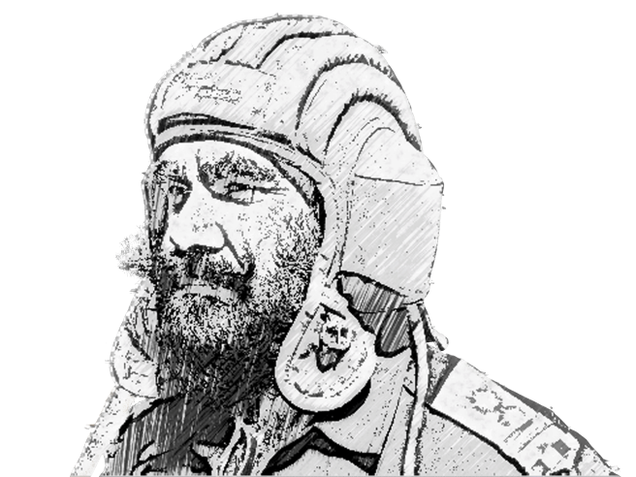
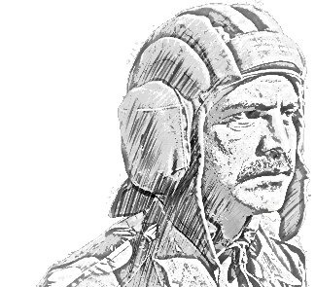
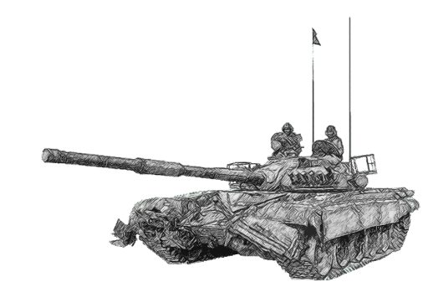
SCHOOL OF TECH TRG
ELECTRONICS WING

Slide 2
BASIC COMN SYS

Slide 3
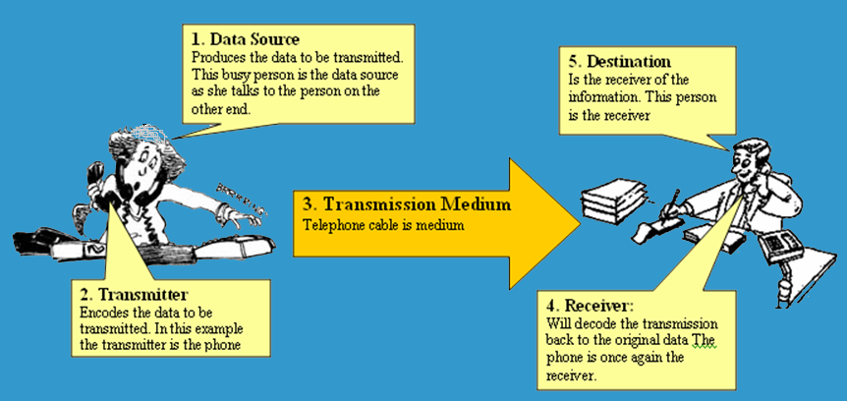
BASIC COMMUNICATION SYSTEM

Slide 4
AIM
To acquaint the class with the “Basic comn sys and various Transmitters and Receivers used in Radio comn sys”.

Slide 5
SCOPE
PHASE I
PHASE II
PHASE III
Types of Electronic Comn
Radio Transmitters and Receivers (basics)
Elements of Comn Sys

Slide 6
PHASE I
ELEMENTS OF COMN SYS

Slide 7
SIGNIFICANCE OF HUMAN COMMUNICATION
Face to face
Signals
Electrical innovations
Written word (letters)

Slide 8
ELEMENTS OF A COMMUNICATION SYSTEM
Transmitter
Channel
Receiver

Slide 9
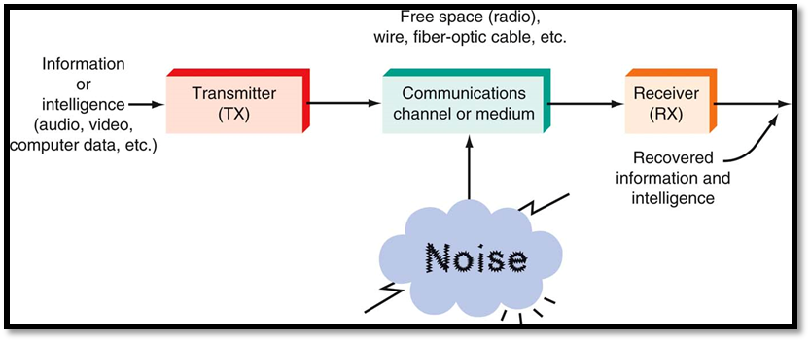
ELEMENTS OF A COMMUNICATION SYSTEM

Slide 10
ELEMENTS OF A COMMUNICATION SYSTEM
TRANSMITTER
Collection of electronic components and circuits
Converts the electrical signal into a signal suitable for txn
Over a given medium
Made up of oscillators, amplifiers, tuned circuits and filters, modulators, frequency mixers, frequency synthesizers, and other circuits.

Slide 11
ELEMENTS OF A COMMUNICATION SYSTEM
COMMUNICATION CHANNEL
Medium by which the electronic signal is sent from one place to another.
Types of media include
Electrical conductors
Optical media
Free space
System-specific media (e.g., water is the medium for sonar)

Slide 12
ELEMENTS OF A COMMUNICATION SYSTEM
RECEIVERS
A collection of electronic components and circuits that accepts the transmitted message from the channel and converts it back into a form understandable by humans.
Contain amplifiers, oscillators, mixers, tuned circuits and filters and a demodulator or detector
Recovers the original intelligence signal from the modulated carrier.

Slide 13
ELEMENTS OF A COMMUNICATION SYSTEM
TRANSCEIVERS
An electronic unit that incorporates circuits which sends and receives signals.
Examples are:
Telephones
Fax machines
Cell phones
Computer modems

Slide 14
ELEMENTS OF A COMMUNICATION SYSTEM
ATTENUATION
Exists in all media of wireless transmission.
Proportional to the square of the distance between the transmitter and receiver.
NOISE
Random, undesirable electronic energy that enters the communication system via the communicating medium
Interferes with the transmitted message.

Slide 15
PHASE II
TYPES OF ELECTRONIC COMN

Slide 16
TYPES OF ELECTRONIC COMN
Classified according to whether they are
One-way (simplex) or two-way transmissions
Duplex

Slide 17
TYPES OF ELECTRONIC COMN
SIMPLEX
Simplest method
One direction only
Examples are:
Radio
TV broadcasting

Slide 18
TYPES OF ELECTRONIC COMN
FULL DUPLEX
Two-way
People can talk and listen simultaneously
Example : Telephone

Slide 19
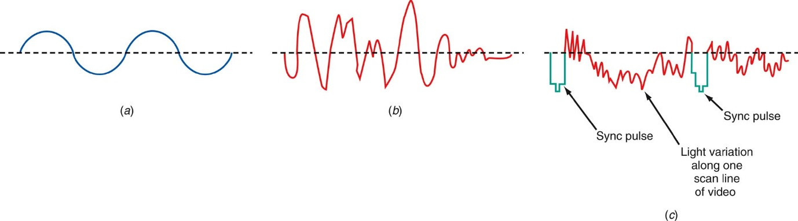
TYPES OF ELECTRONIC COMN
ANALOG SIGNALS
A smoothly and continuously varying voltage or current.
Examples:
Sine wave
Voice

Slide 20
TYPES OF ELECTRONIC COMN
DIGITAL SIGNALS
Change in steps or in discrete increments.
Most digital signals use binary or two-state codes.
Examples
Telegraph (Morse code)
Serial binary code (used in computers)

Slide 21
TYPES OF ELECTRONIC COMN
SNO | Digital Comn | Analog Comn
1 | Increased immunity to noise | Simple
2 | Different types of message signals as voice data, video data, or computer data can be implemented in the same format by the transmitter. | Not very expensive
3 | Message signals can be encrypted to provide security | Radio and Telephone networks
4 | Very complex and can be costly for communication channel such as satellite channels and optical fibers.

Slide 22
PHASE III
RADIO TRANSMITTERS AND RECEIVERS

Slide 23
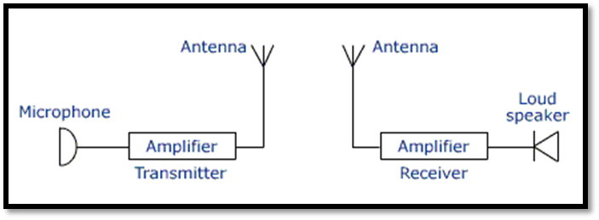
BLOCK DIAGRAM OF TRANSMITTER AND RECEIVER
EM waves in the frequency range of 20 Hz - 20 kHz (audio-frequency range)
Cannot be efficiently radiated
Do not propagate well in space.
Simultaneous transmission of different signals by different transmitters would lead to confusion at the receiver.

Slide 24
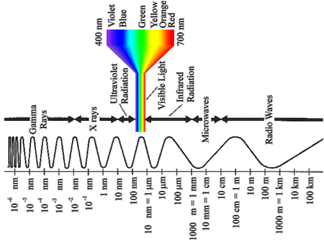
ELECTROMAGNETIC SPECTRUM

Slide 25
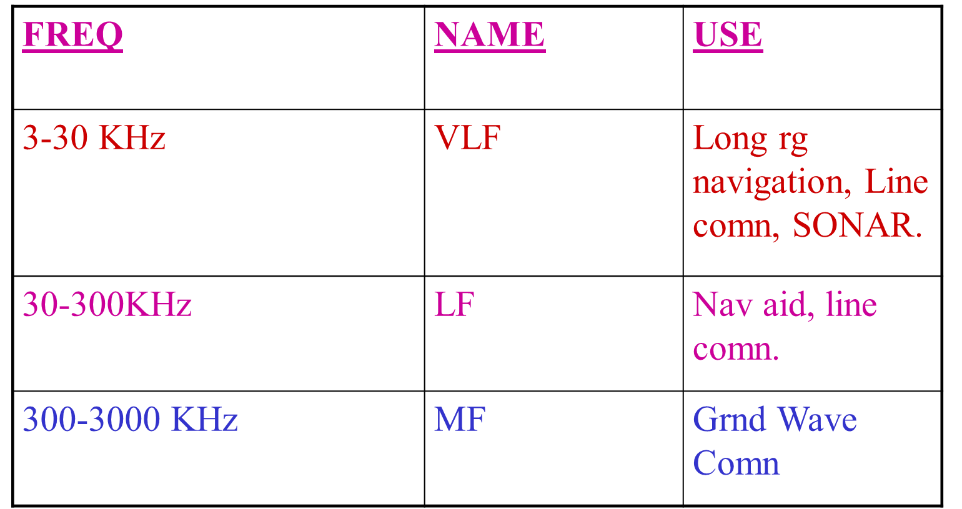
ELECTROMAGNETIC SPECTRUM

Slide 26
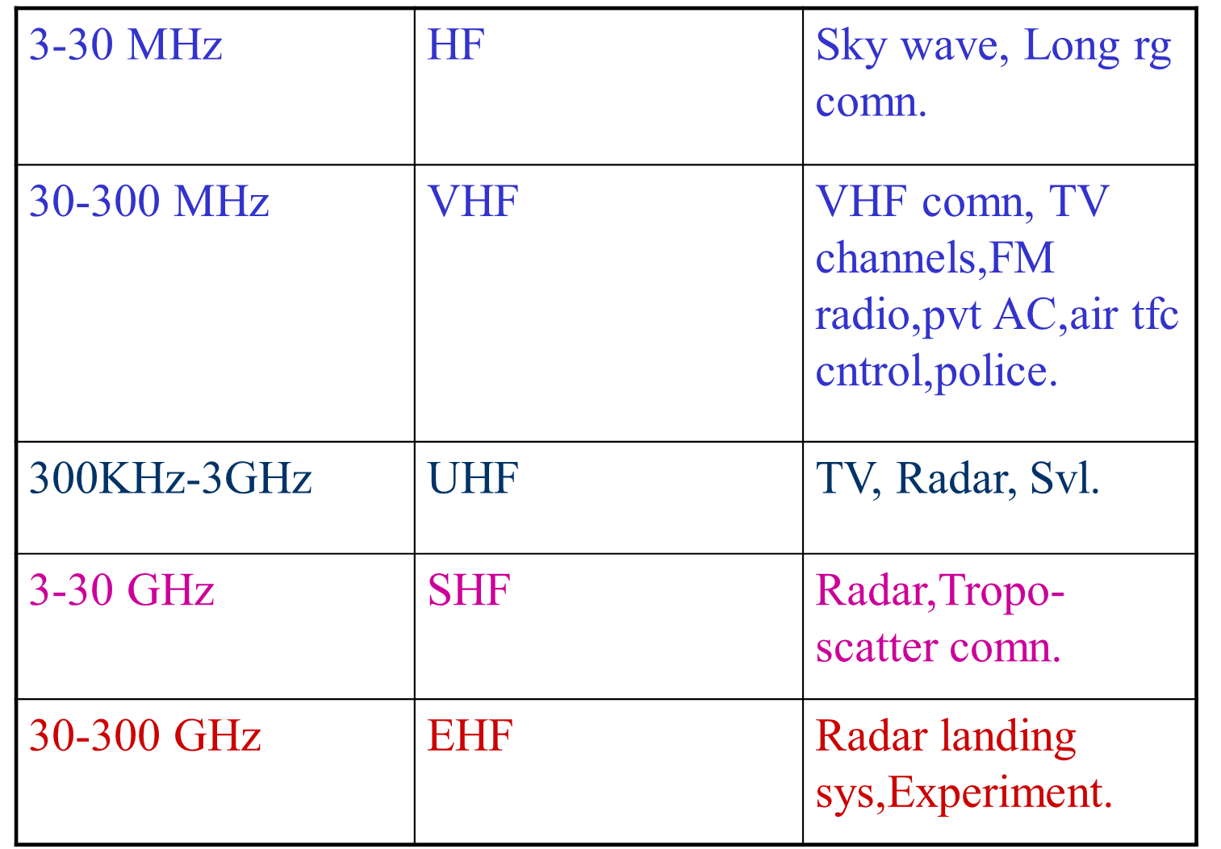
ELECTROMAGNETIC SPECTRUM

Slide 27
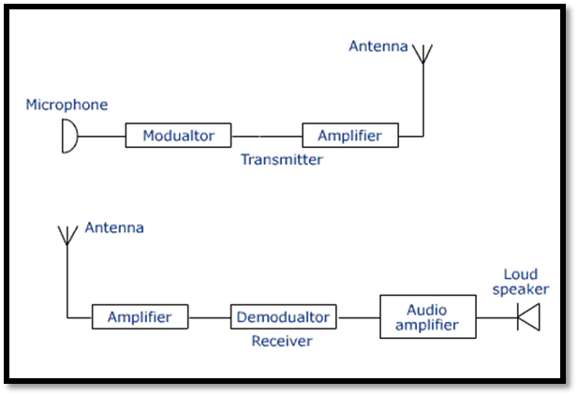
BLOCK DIAGRAM OF TRANSMITTER AND RECEIVER

Slide 28
MODULATION
Process of superimposition of audio signal on high frequency carrier wave.
On adding the audio signal to carrier, any one of the characteristics namely amplitude or frequency or phase of the carrier wave is changed in accordance with the intensity of the audio signal. This process is known as modulation.

Slide 29
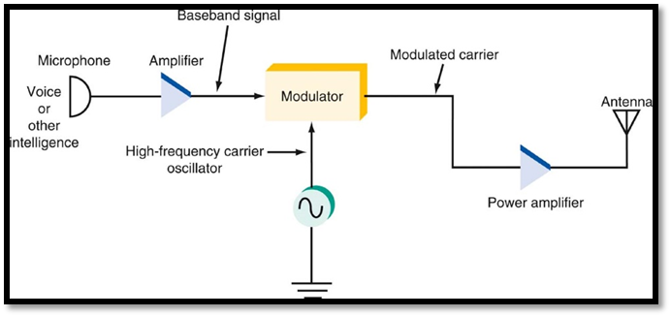
BASIC DIAGRAM OF TRANSMITTER

Slide 30
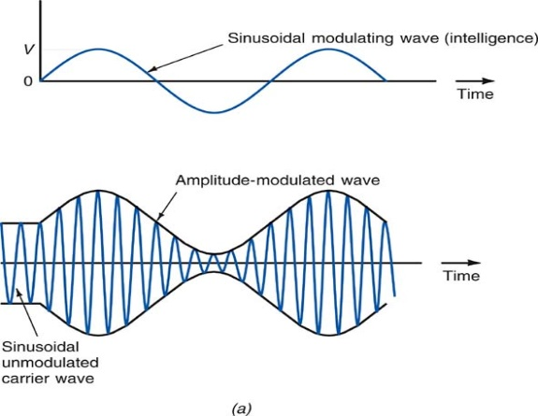
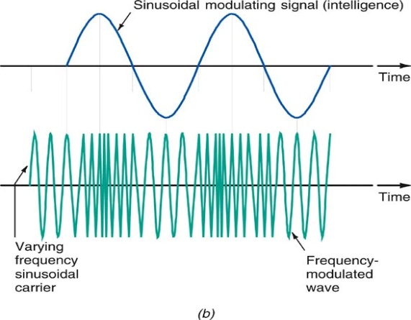
TYPES OF MODULATION

Slide 31
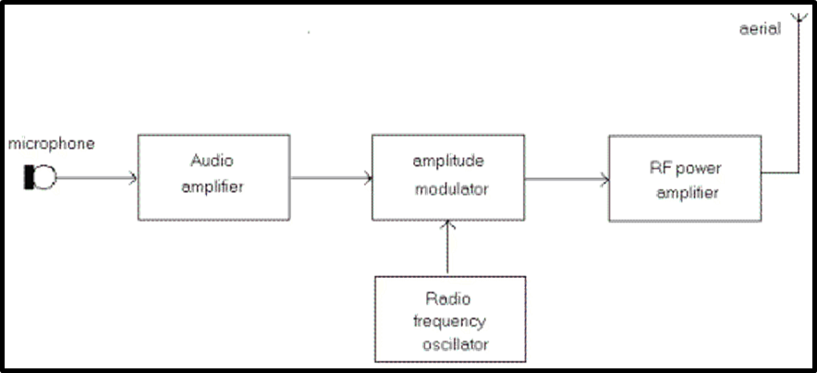
AM TRANSMITTER

Slide 32
AM TRANSMITTER
Microphone converts sound waves into electrical signals (a range of 20 Hz to 20 kHz).
Signals are amplified by the audio frequency amplifier.
Carrier frequency is generated by the radio frequency oscillator.
Audio is superimposed onto the carrier by the modulator.
Low power modulated carrier is boosted in amplitude by the radio frequency power amplifier.
Aerial produces an electromagnetic wave which is radiated into space.

Slide 33
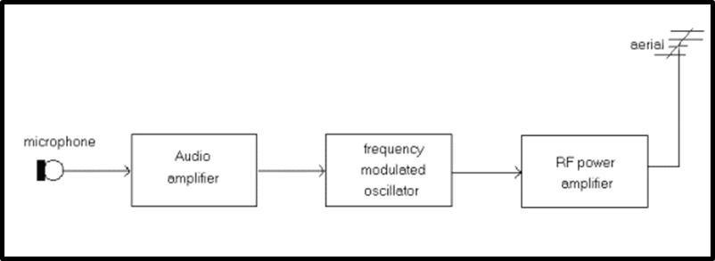
FM TRANSMITTER

Slide 34
FM TRANSMITTER
Microphone converts sound pressure wave to electrical signals.
Audio voltages are amplified by the audio amplifier.
Amplified audio is used to control the deviation of the frequency controlled oscillator.
Oscillator frequency is at the carrier frequency, in the 88-108 MHz FM band.
Low power of the frequency modulated carrier is boosted by the Radio Frequency amplifier.
Aerial is driven by the amplifier and produces an electromagnetic wave.

Slide 35
RADIO RECEPTION
A radio receiver has the function of
Selecting the desired signal from all other unwanted signals
Amplifying,
Demodulating
Producing it in the desired manner.
Disadvantages of Simple radio receiver circuit
Poor sensitivity- the ability to amplify the weak signals
Poor selectivity- the ability to select a particular wanted signal only and rejecting the unwanted signals.

Slide 36
RECEIVER PARAMETERS
SENSITIVITY
SELECTECTIVITY
STABILITY
FIDELITY
SN RATIO.

Slide 37
BASIC TYPES OF RECEIVER
Tuned Radio Freq (TRF)
Super Heterodyne Receiver

Slide 38
TUNED RADIO FREQ (TRF)
Amplifiers ( Chain)
Detector Circuit (Demodulator).
Concept- Desired sig amplification at every stage
Multiple stages of amplification.
Three section
More than one RF amplifiers.
Detector
Audio amplifier
No freq conversion.
Less in use
Q= RX Sqroot of C/L .
ANT
RFA
DETECTOR
AUDIO
HEAD PHONE

Slide 39
THE SUPER HETERODYNE
PRINCIPLE OF OP
Super heterodyne = supersonic heterodyne.
Supersonic = more than human hearing capacity.
Hetero = different
Dyne = power
ANT
demodultor
RF amp
mixer
filter
IF AMP
OSCILLATOR
Audio amp

Slide 40
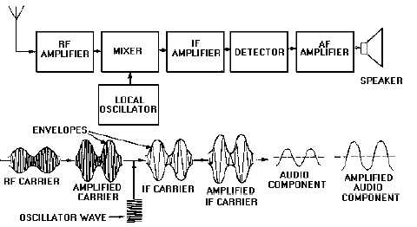
SUPER HETERODYNE RECEIVER

Slide 41
THE SUPER HETERODYNE
Advantages
Stability
No variation in BW
Better selectivity
Disadvantages
Image freq

Slide 42
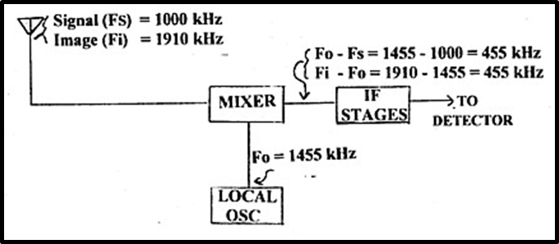
SECOND CHANNEL OR IMAGE FREQUENCY

Slide 43
COMPARISON
TRF RECEIVER
SUPER HETERODYNE RECEIVER
No frequency conversion
No IF frequency
Instability , variation in BW and poor selectivity due to high frequencies
Difficult to design tunable RF stages.
Rarely used
Frequency conversion
Downconvert RF signal to lower IF frequency
No instability,high selectivity as IF introduced.
Main amplification takes place at IF
Mostly used

Slide 44
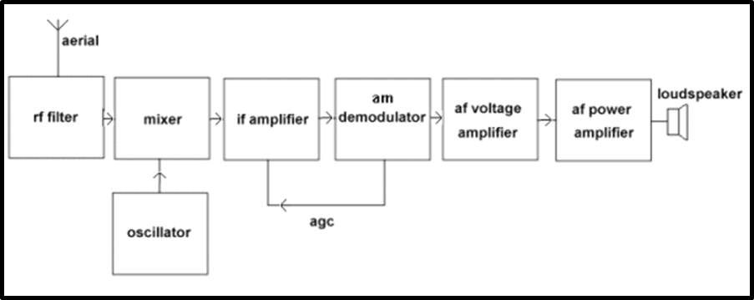
AM RECEIVER

Slide 45
AM RECEIVER
Selected frequency is applied to the mixer.
Output of an oscillator is also applied to the mixer.
Mixer and oscillator form a FREQUENCY CHANGER circuit.
Output from the mixer is the intermediate frequency (IF).

Slide 46
AM RECEIVER
IF is a fixed frequency of about 455 kHz.
No matter what the frequency of the selected radio station is, the IF is always 455 kHz.
The IF signal is fed into the IF amplifier.
The advantage is that its frequency and bandwidth are fixed, no matter what the frequency of the incoming signal is.
This makes the design and operation of the amplifier much simpler.

Slide 47
AM RECEIVER
The amplified IF signal is fed to the demodulator.
This circuit recovers the audio signal and discards the RF carrier.
Usually incorporates a diode in the circuit.
Some of the audio is fed back to the IF amplifier as an AUTOMATIC GAIN CONTROL voltage.
The audio signal voltage is increased in amplitude by a voltage amplifier.
The power level is increased sufficiently to drive the loudspeaker by the power amplifier.

Slide 48
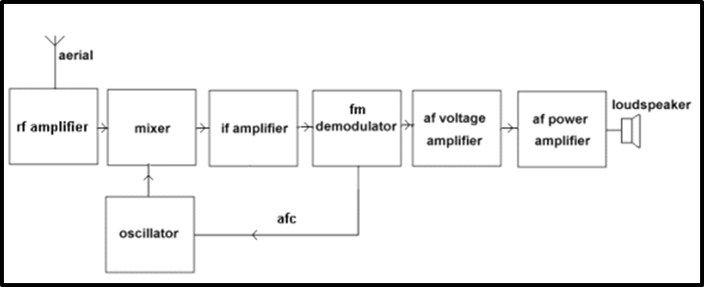
FM RECEIVER

Slide 49
FM RECEIVER
The selected frequency is applied to the mixer.
The output of an oscillator is also applied to the mixer.
The mixer and oscillator form a FREQUENCY CHANGER circuit.
The output from the mixer is the intermediate frequency (IF).
The IF is a fixed frequency of 10.7 MHz. No matter what the frequency of the selected radio station is, the IF is always 10.7 MHz.

Slide 50
FM RECEIVER
The audio signal voltage is increased in amplitude by a voltage amplifier.
The power level is increased sufficiently to drive the loudspeaker by the power amplifier.
The IF signal is fed into the IF amplifier.
The advantage of the IF amplifier is that its frequency and bandwidth are fixed, no matter what the frequency of the incoming signal is.

Slide 51
FM RECEIVER
The amplified IF signal is fed to the demodulator.
This circuit recovers the audio signal and discards the RF carrier.
Some of the audio is fed back to the oscillator as an AUTOMATIC FREQUENCY CONTROL voltage.

Slide 52
KEY TAKE AWAYS
Basic Comn Sys Layout
Types of Comn
Types of Tx
Superhetrodyne Receiver

Slide 53
CONCLUSION

